Slide 1
7 Key Principles of Software Testing
Presented By:
Piyush Dabhi

Slide 2
Testing shows the presence of defects
Exhaustive testing is impossible
Early testing
Defect clustering
Pesticide Paradox
Testing is Context-Dependent
Absence of Errors Fallacy

Slide 3

Testing shows the presence of defects
A lot of people think that testing can
prove that there are no defects within
the software under test.
Software testing reduces the presence
of defect.
Even multiple testing can never ensure
that software is 100% bug free.

Slide 4

Exhaustive testing is impossible
Exhaustive testing is impossible means the
software can never test at every test cases.
Test everything is for sure very expensive
both in time and money terms.
Just in exceptional cases can be possible to test everything, otherwise test execution is affected from time, budget, risk analysis, testing techniques and priorities.

Slide 5
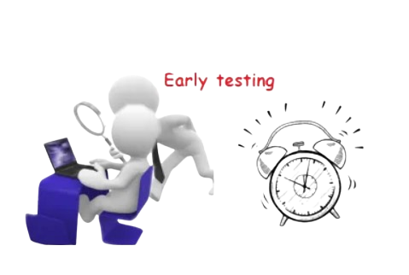
Early testing
Test activities should start as soon as possible over a Software Development Life Cycle (SDLC).
Its easier to fix defects in early phase of the project
Finding defects in early phase of project will very less expensive.

Slide 6
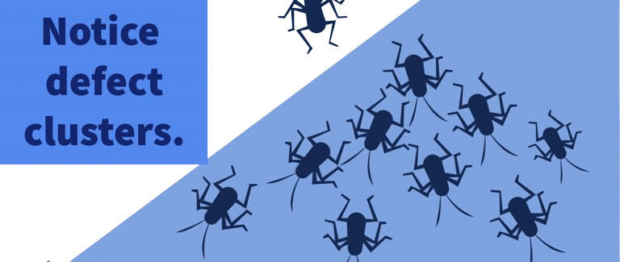
Defect clustering
Defect clustering in software testing refers to a non-uniform distribution of defects throughout the application. It is instead concentrated in a few select areas of the application.
In a project small number of the module can contain most of the defects.

Slide 7
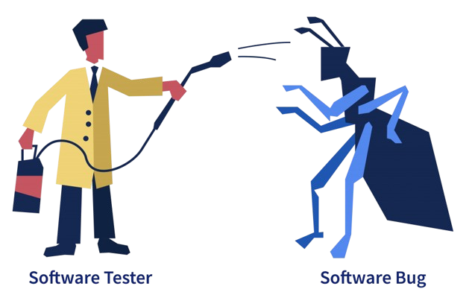
Pesticide Paradox
When the same tests are repeated over and over the risk is that they are not eventually discovering other issues anymore, like a pesticide.
Test case should be updated.
Test data should be updated.

Slide 8

Testing is Context-Dependent
Testing approach depends on context of software developed.
Different types of software needs to perform different types of testing.
We can use a different approach, methods, techniques and the types of tests depending on the type of application.

Slide 9
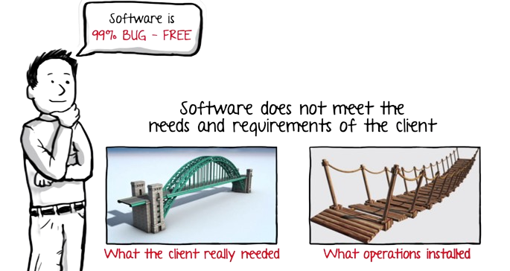
Absence of Errors Fallacy
It is possible that software that is 99% error free is still unusable
Software testing is not only the discovery of defects, but also the verification that software meets the business needs.

Slide 10


